Slide 1


Co-op & Co.
Co-op & Co
No Plan, No Problem!
No Plan, No Problem
Co-Op and Co

Slide 2

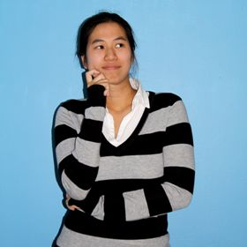
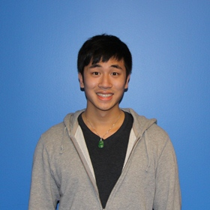
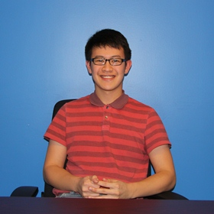
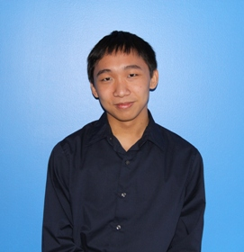
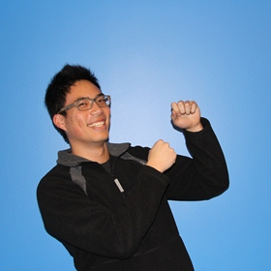
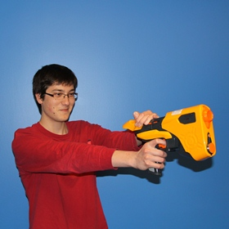
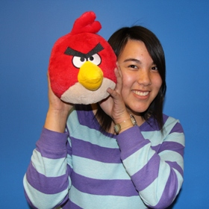
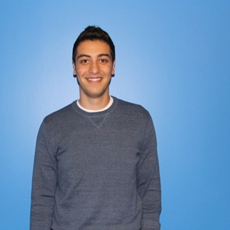
Who are we?
Karen Li
Billy Hon
Steven Hsu
Vincent Cua
Nick Ho
Erick Costigan
Michelle Wong
Nick Ghotbi

Slide 3


Slide 4

Our Goal
Present
Ease of Cortex integration into existing games
Seamless in-game transactions
Effortless revenue generation
Flexibility of Cortex

Slide 5

What we Actually Accomplished
Unity
Powerful game engine used by Studios and Independent Developers across 10 platforms
iOS, Android, Windows, Mac, Xbox, PS3, and more!
Integrated Cortex
Simple micro transactions of digital and physical goods

Slide 6

Walk Through Demo

